Slide 1
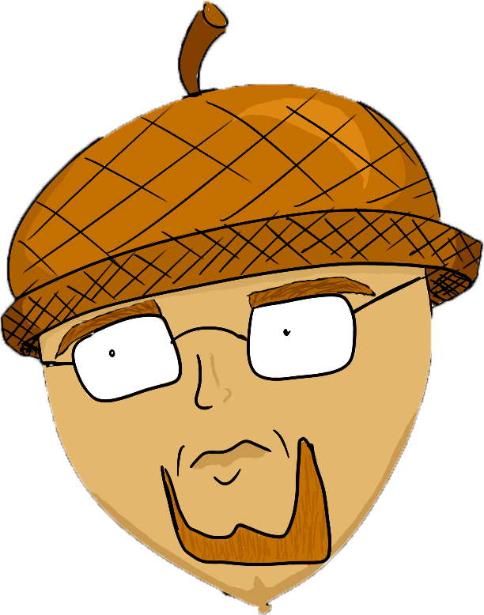
Mr. Adelmund
My year in review

Slide 2
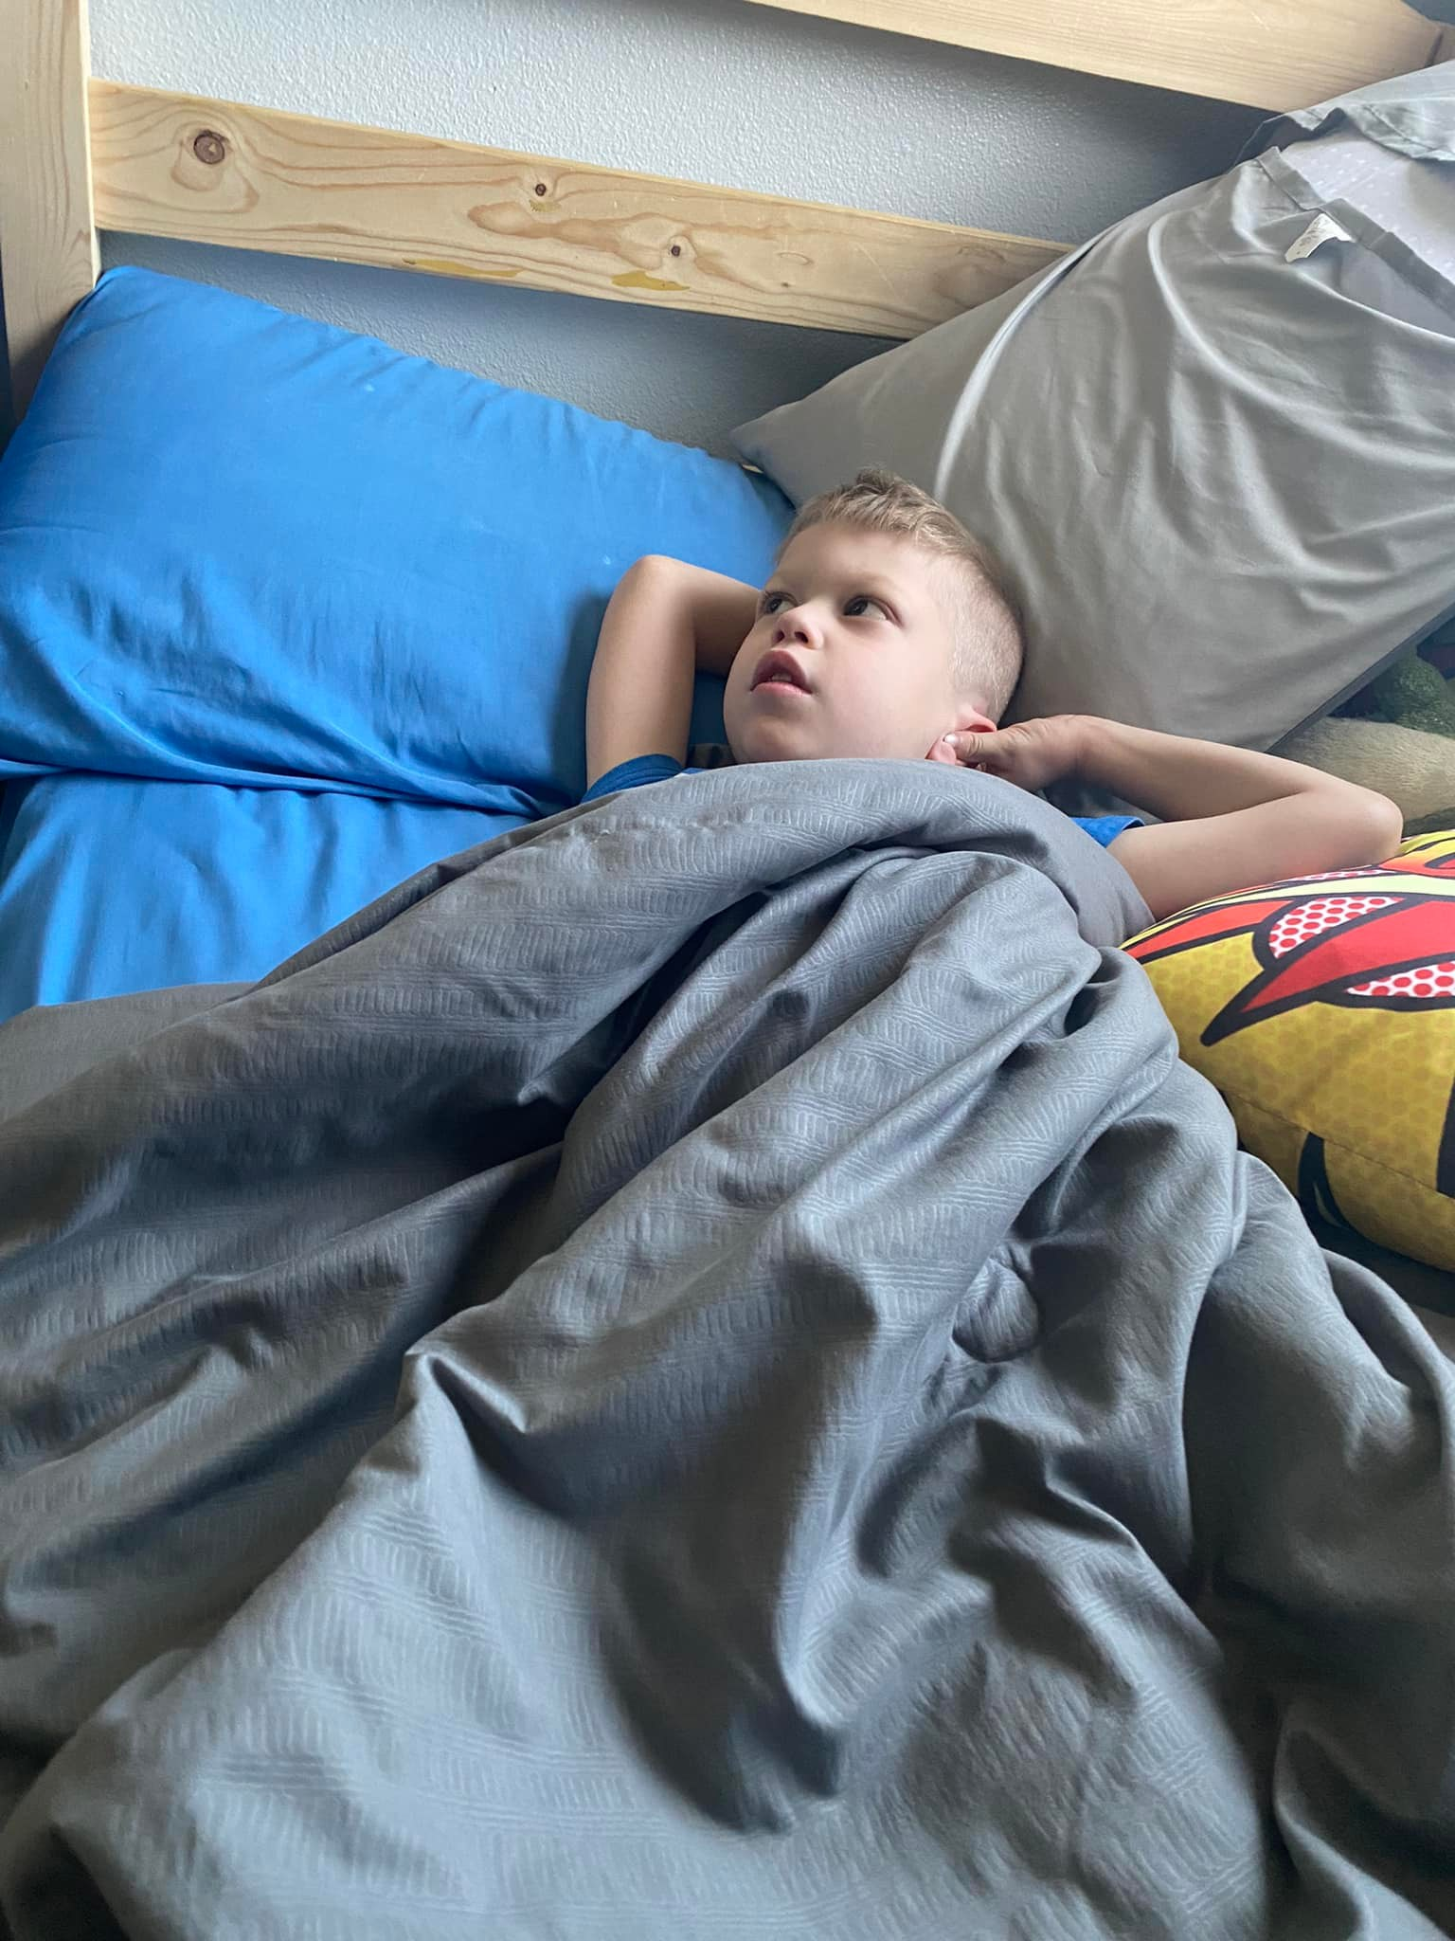
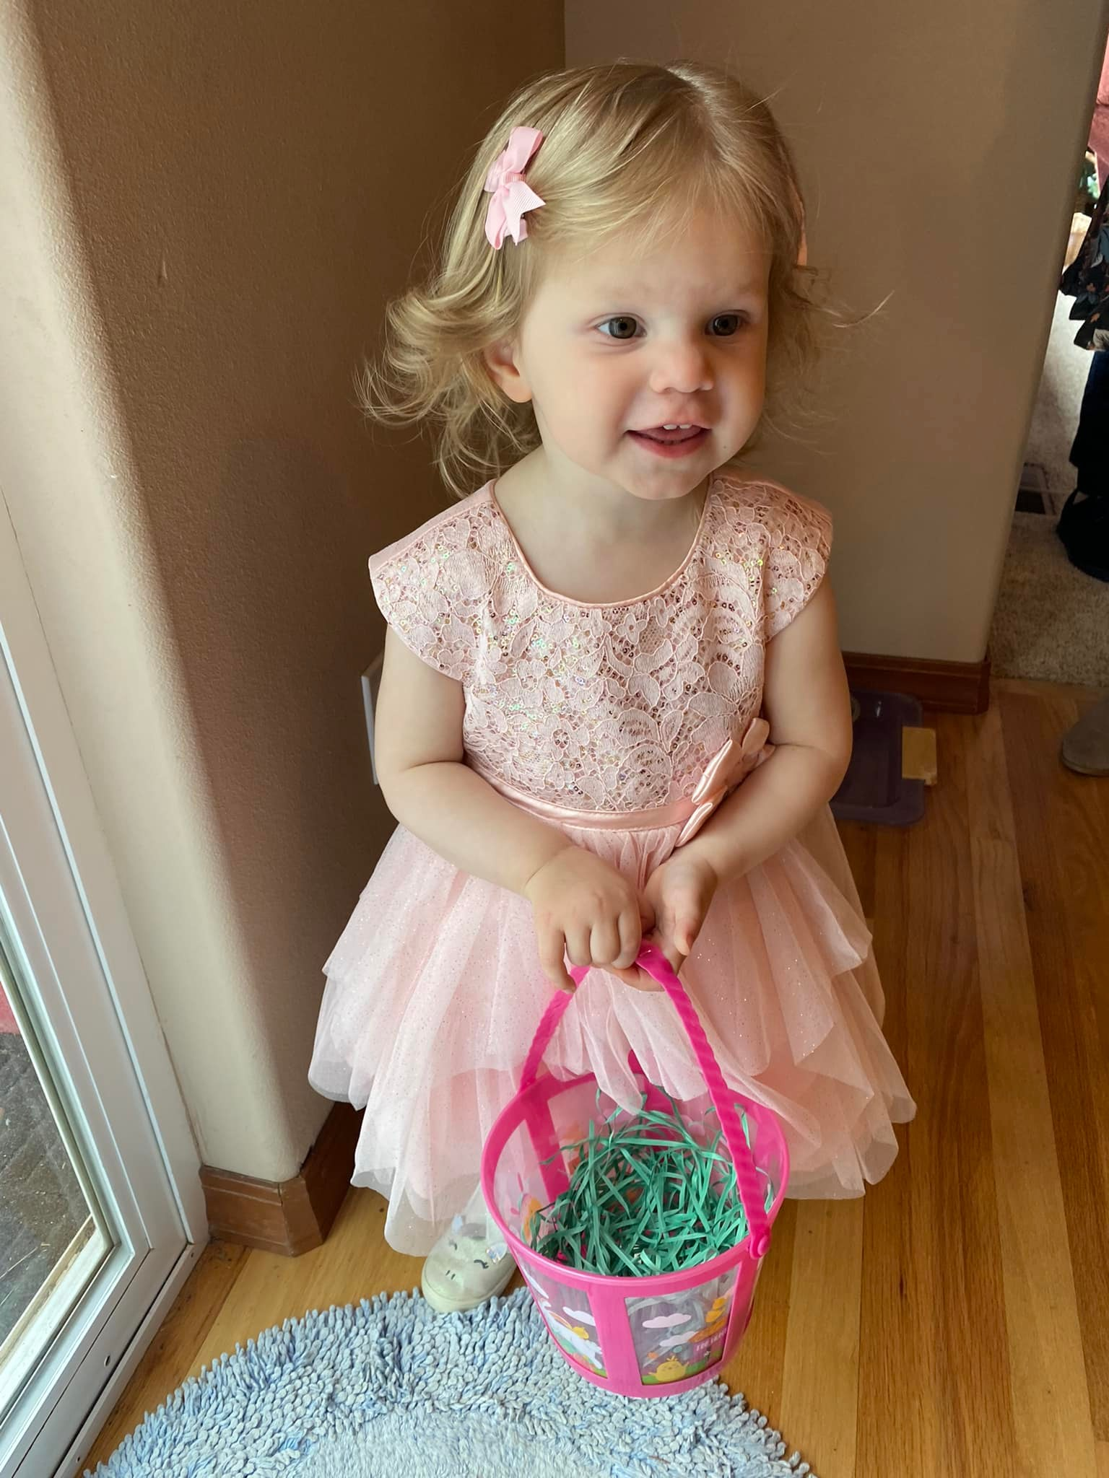
About Me
Love to read, cook, play games
6 year old son
2 year old daughter
Married 13 years
Math degree from UW
Masters from WGU
5 years at PNNL
7th year teaching

Slide 3
Successes
Second-year App Challenge submissions
Blender/art
Github
Site council

Slide 4
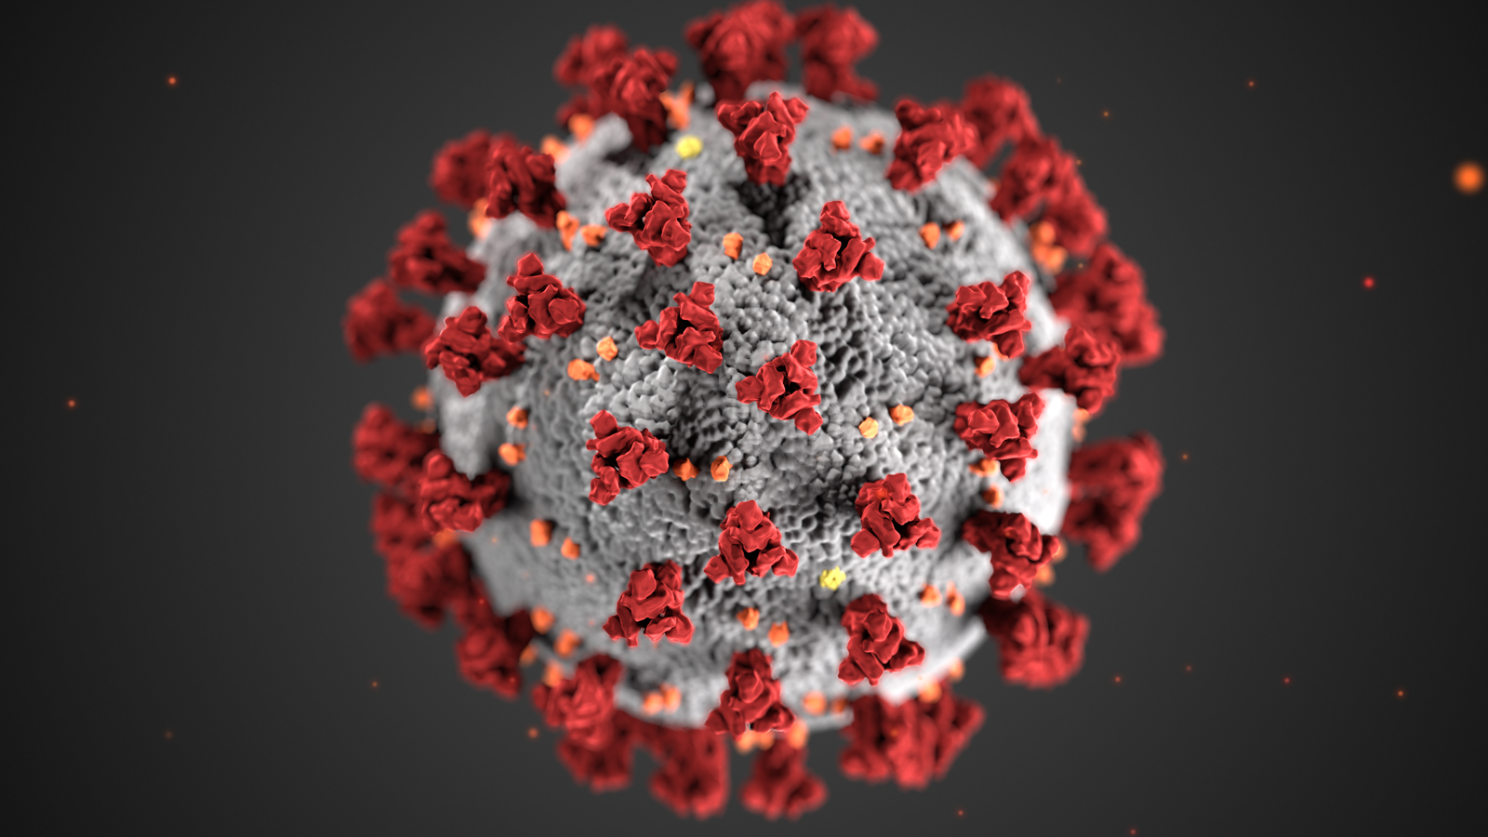
Challenges
Communication with parents
Covid
Organization
Guest speakers

Slide 5
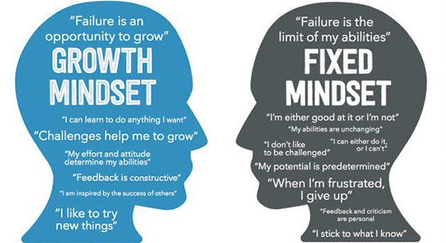
Personal Satisfaction
Very good year
Growth mindset
Personal growth
Learning from students
Admitting I don’t know

Slide 6

Career Plans
Continue teaching
GDC
Game development
Continue site council

Slide 7
Tri-Tech Advantages/Disadvantages
Advantages:
I get to teach about something I love
Long periods
Meet students with similar interests
Disadvantages:
Weird schedules
Bus schedules
IT
Tour days

Slide 8
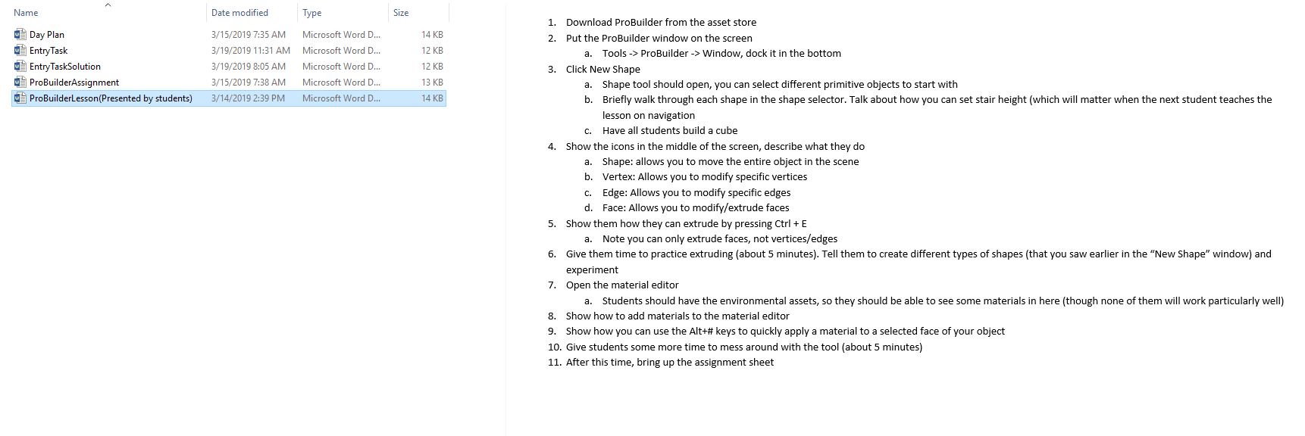
Work Examples

Slide 9
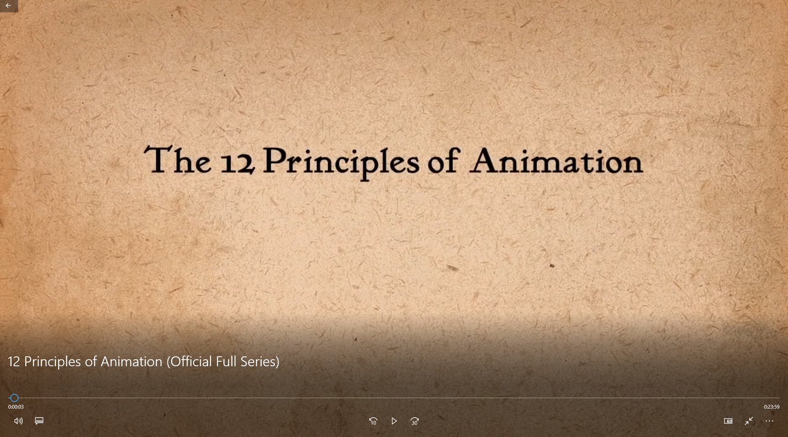
Work Examples

Slide 10
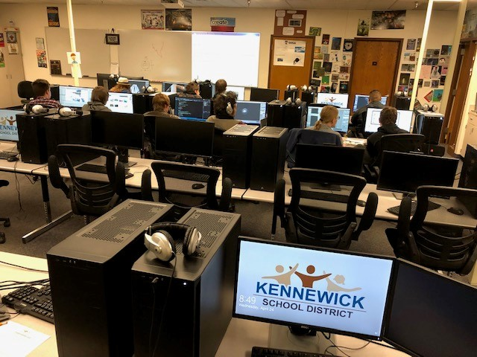
Work Examples

Slide 11
Work Examples

Slide 12
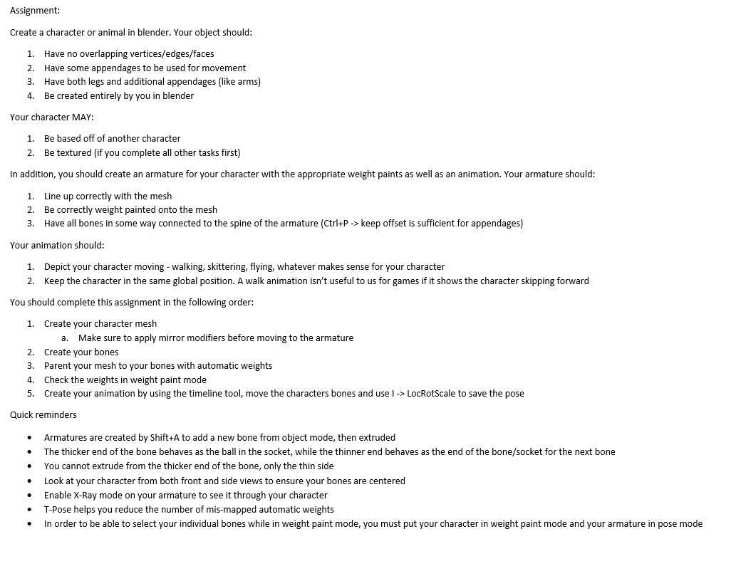
Work Examples

Slide 13
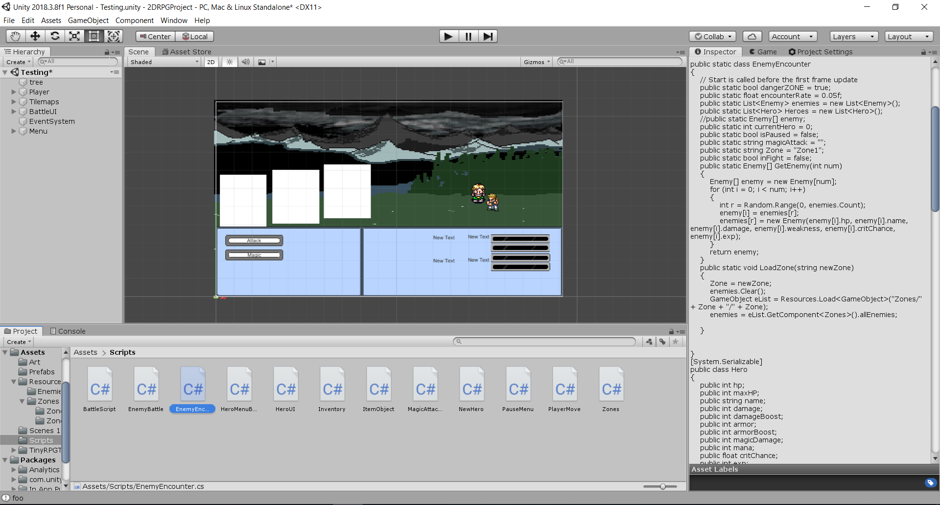
Work Examples

